Slide 1
NATIONAL INSTITUTE OF TECHNOLOGY KARNATAKA
CAPSTONE PROJECT
Savonius Wind Turbine Blade Design and Performance Analysis
Project Guide: Dr. Sathyabhama A
Group Member:
Pranav Bhosale 221ME211
Devesh Bramhne 221ME114
Vaibhav Kedar 221Me325
Shreyas Nageshwar 221ME349

Slide 2
Wind Turbine
A wind turbine is a device that converts the kinetic energy of wind into electrical energy. Wind turbines use blades that collect the wind's kinetic energy, which creates lift and causes the blades to turn. The blades are connected to a drive shaft that turns an electric generator, which produces electricity.
There are 2 types of wind turbines:
1) Horizontal Axis Wind Turbine(HAWT)-
i) In it the axis of rotation of blade of the turbine is parallel to the direction of the wind.
ii)This is most commonly use wind turbine to produce electricity.
iii) It produce electricity in the large scale and thus have large efficiency.
2) Vertical Axis Wind Turbine(VAWT)-
i) In it the axis of rotation of blade of the turbine is perpendicular to the direction of the wind.
ii) This wind turbine is used for small scale production of the electricity like for one house.
iii) VAWT’s are not that much efficiency of that HAWT, but still there are some advantages over HAWT.
Furter there are 2 types of the VAWT:
Drag Type- Blades are moved due the drag force experienced by the blades due to the wind. Has simple structure and less efficient. Eg. Savonius Wind Turbine
Lift Type- Blades are moved due the lifting force experienced by the blades. Are more complex than drag type and also more efficient. Eg. Darrieus Wind Turbine

Slide 3
Advantages of VAWT over HAWT:
Can be located at ground level/sea level.
Simpler blade geometry.
Lower blade tip speed, and thus less noise is created.
Wind direction doesn’t matter, omni directional wind turbine.
Automatic orientation of the blade direction towards the wind direction.
Gearbox, generator can be placed at ground level.
Easy maintenance.
Disadvantages:
No self start, we have to start the rotation of the blade externally.
Height is low and thus inefficient to utilize the wind at high attitude.
Due to the creation of the aerodynamic dead zone, efficiency the turbine decreases.

Slide 4
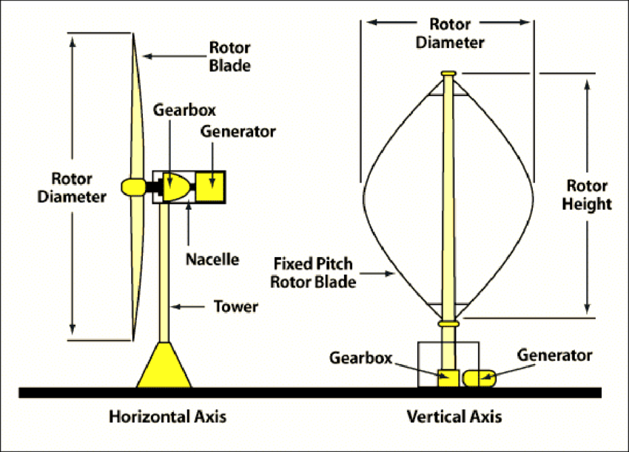
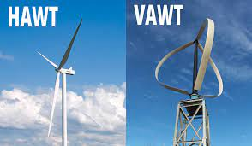
Fig. Different parts of HAWT and VAWT
(www.google )
Fig. HAWT and VAWT
Source- Google

Slide 5
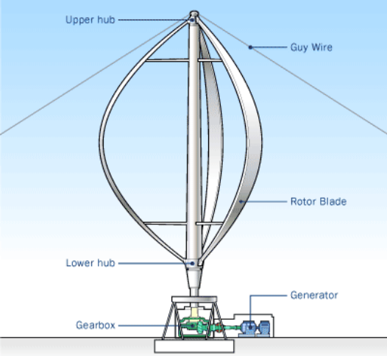
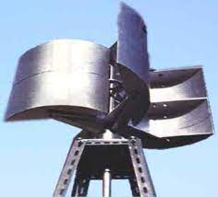
Comparison of the Darrieus and Savonius Wind Turbine:
Characteristics | Darrieus Wind Turbine | Savonius Wind Turbine
Force | Lift | Drag
Torque | Low | High
Rotational Speed | High | low
Self Start | No | Yes
Efficiency, Tip Speed, Power Coefficient | High | Low
Fig. Darrieus Wind Turbine
Fig.Savoniius Wind Turbine
Source-Google

Slide 6
Savonius Wind Turbine:
Johann Ernst Bessler made the first attempt to build such a wind turbine in Furstenberg, Germany, in 1745. Savonius turbine is a simple vertical axis device. Depending on total number of blades, it has half-cylindrical blades attached to the main shaft opposite to each other (for two bladed), which creates the drag force from incoming wind and generates mechanical torque, which drives the generator for electricity generation.
Invented by Finnish Engineer, Sigurd Savonius in 1920.
It contains of 2-3 scoops like blades which rotates due to drag force.
This drag action is used to convert the wind energy into mechanical which rotes the shaft and thus electricity is generated.
Blades can rotate in any direction regardless of facing.
Rotational speed is low but it produces high torque.
It is slow speed wind turbine.
Not commonly preferred for large energy production.
There are two half cylindrical or elliptically blades arranged in ‘S’ shape.
First blade is called Advancing blade and second is called Returning blade.
Drag coefficient of the concave surface is high than that of convex.

Slide 7
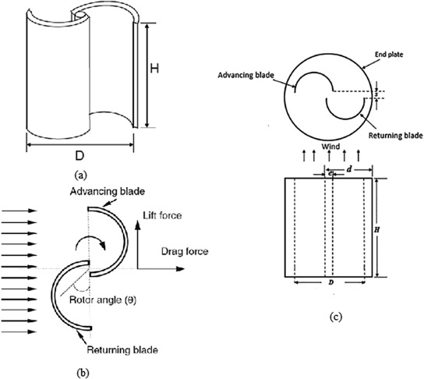
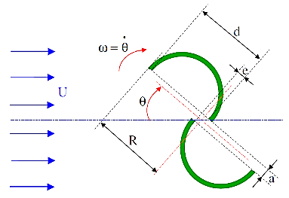
Fig. Blade profile
(google)
Profile of blade
Source: Google

Slide 8


Some Important Terms:
1)Power Characteristic- Total power available from wind for electricity generation.
where, ρ is air density (kg/m3 )
V is the wind speed (m/s)
A is the cross-sectional area of the turbine.
2)Tip Speed Ratio(TSR)- Ratio between the tip speed of the blade to the inlet wind velocity.
3) Blade Arc Angle- The blade arc angle is the angle of the cup from inside to the tip of the blade, and a change in blade arc angle leads to variation in drag forces.

Slide 9
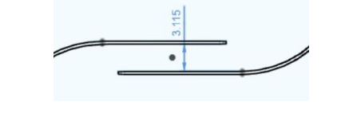
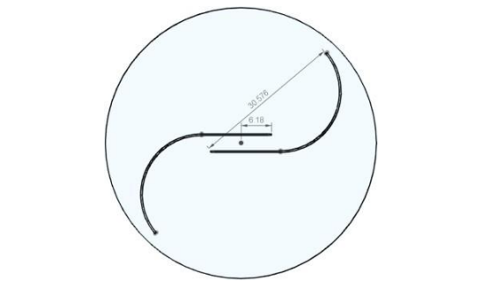
4)Distance Between Blades- The gap between the two blades is simply measured from blade to blade.
5)Overlap Ratio (OR)- The overlap ratio is defined as the ratio between the overlap distance and the radius of the blade.
6)Aspect Ratio(AR)-The aspect ratio is defined as the ratio of the rotor radius to the blade length. The efficiency of the blade is proportional to the aspect ratio.
Fig. Distance between blades
(https://www.sciencedirect.com/science/article/pii/S1364032122004324#sec1)
Fig. Top view of SWT blade
(https://www.sciencedirect.com/science/article/pii/S1364032122004324#sec1)

Slide 10
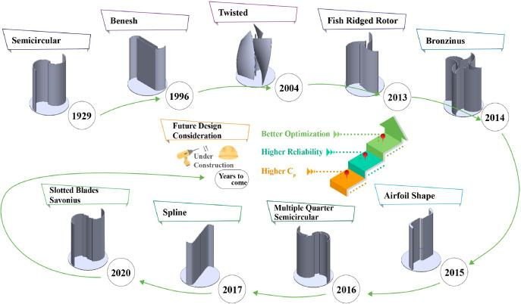
Blade Designs of the Savonius Wind turbine year by year
https://ars.els-cdn.com/content/image/1-s2.0-S1364032122004324-gr2.jpg

Slide 11
Recent Trends in Blade Design:
Aerodynamic, material science, manufacturing technologies, smart system integration are the main areas where we can make modification to design more efficient blade for turbine.
Aerodynamic Optimization: We can optimizing the blade shape, curvature, and orientation to improve the capture and conversion of wind energy.
3D Printing Technology: We can customize the design of the blade for specific wind conditions to increase the efficiency.
Composite Material: We can shift towards using lightweight and durable composite materials for Savonius turbine blades. Composite materials offer advantages such as high strength-to-weight ratio, corrosion resistance, and flexibility in design, allowing for more efficient and durable blades. Composite materials like carbon fibre composite, advanced polymer, hybrid materials.
Smart Blade Technology: We can add sensors within the blade to detect the wind direction itself and can get oriented itself accordingly. We can also add control systems.
Segmented Blade Configuration: This can help us in easier transportation, assembly and maintenance of turbine. Segmented bodies give flexibility in the blade length adjustment, and allow for quick replacement of damage sections, reducing downtime and cost of maintenance.
Integration of Additive Manufacturing: We can use Laser Sintering to manufacture blades. Laser Sintering is a type of 3D printing in which powder is fuse into solid by using laser thermal energy.
Elliptical Blades: The blades have been changed from cylindrical to elliptical to improve aerodynamic efficiency.
Helical Model: The helical model has been modified to reduce wind resistance.
We can use above mentioned technologies to optimize the blade design and increase the efficiency of the all type of turbine including HAWT and VAWT.

Slide 12
Some methods to optimize the SWT-
Airfoil Based SWT- A new airfoil-based SWT with a high Cp was developed. They observed a 27% increase in Cp for an optimum airfoil-based SWT.
Scooplet- It showed a 39% increase in the maximum Cp for the suggested scooplet-based design compared to the standard design.
Omni-Directional Guide Vane(ODGV)- Suitable for all directional wind flow.
Deflected Plate- The efficiency increased by up to 30% by using deflected plate.
Slotted Blade- The Cp value obtained using this slotted blade is 14.4% higher than that obtained using the conventional setup.
Multiple Layer- The Cp value obtained using multiple layer is 17.6% higher than that obtained using conventional setup.
Use of AI to Optimize the blade design:

Slide 13
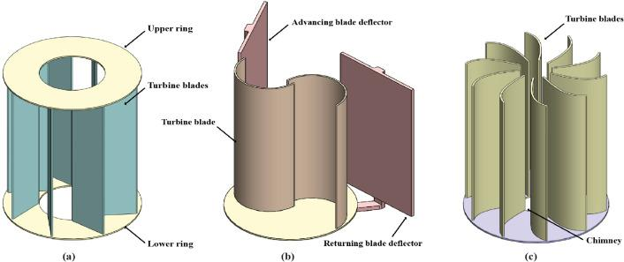
(a)ODGV Model (b)Deflector Plate (C)Radial Wind Turbine
(https://www.sciencedirect.com/science/article/pii/S1364032122004324#sec1)

Slide 14
Optimization Using AI:
The AI-based optimization technique requires simply a set of available turbine data that can be fitted with a machine learning or neural network model to estimate the possible output from the SWT.
With few lines of code, this approach can assess a vast number of design factors.
In very short time, the optimizer and AI-based prediction model can check hundreds of combinations.
Hence, the optimization process requires less cost, minimum pieces of infrastructure, and a very short amount of time.
And hence optimization becomes easy.
On the other hand, optimization using traditional techniques requires lot of efforts and much more time.
Traditional techniques include, creation of SWT model form given data and this model is tested using simulation model and calculate the value of Cp using a corresponding formula.
Computational analysis of each and every part of SWT and then checking for all optimum design of the SWT requires lot if time, money and efforts.
Therefore, optimization using AI is now becoming a future, as it requires less cost, time, efforts and gives best design.

Slide 15
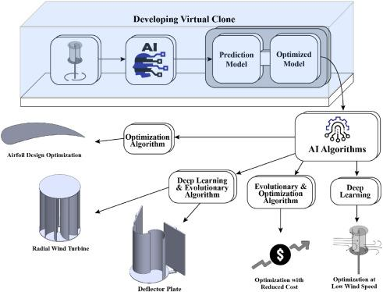
Use of AI to optimize the blade design and hence to increase the efficiency of the turbine
Fig. Use of AI to optimize the blade design
(https://www.sciencedirect.com/science/article/pii/S1364032122004324#sec1)

Slide 16
Objectives of the Project:
Increase the efficiency of the SWT using modern technologies, performing simulations, analysis on the model of SWT.
Optimize the blade design to get more efficient SWT model by performing simulations.
Thinking on a composite material for the blade with good mechanical properties and lightweight also corrosion resistance, suitable for various conditions.
Also if possible try to use smart blade technology, omni-directional guide vane, AI optimization.

Slide 17
References:
1) Towards next generation Savonius wind turbine: Artificial intelligence in blade design trends and framework
https://www.sciencedirect.com/science/article/pii/S1364032122004324#bib1
2) Wind turbine
https://en.wikipedia.org/wiki/Wind_turbine
3) Video- Vertical Axis Wind Turbine Aerodynamics and Design
https://youtu.be/ldt405jIR0E?si=IQ-abx_BYVOAuqGJ
4) Video- Comparison of efficiency of various wind turbines Savonius, Darrieus, HAWT
https://youtu.be/JUGKoUUzimU?si=bmnRPwK9KjAOY1vo

